Slide 1

TIER-Plus: Supporting evidence-informed prioritization and trade-off analysis in HIV service planning
HIV service delivery prioritization in resource-constrained settings
Brooke Nichols, Boston University
18 August 2026

Slide 2
Who is TIER-Plus for?

Slide 3

Let’s take a look
ORIENTATION
INPUTS (country & coverage)
SCENARIOS (adjust interventions)
4. OUTPUTS (costs + outcomes + cascades)

Slide 4
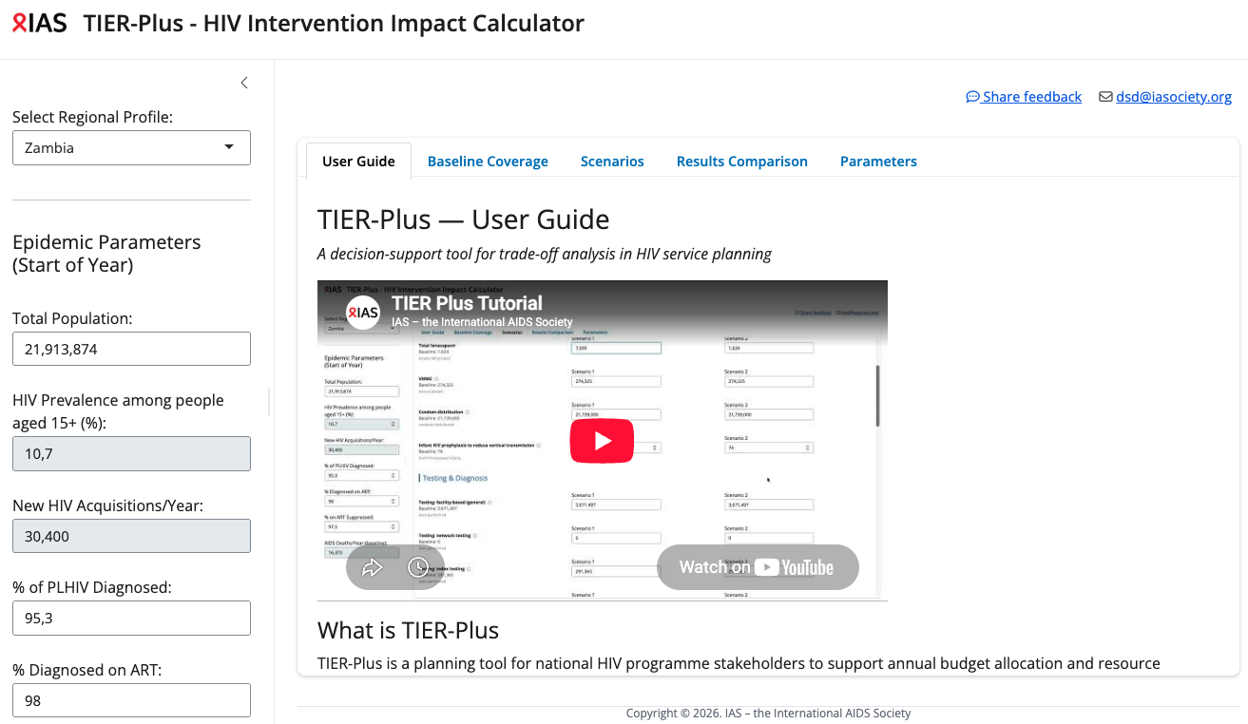
Orientation

Slide 5
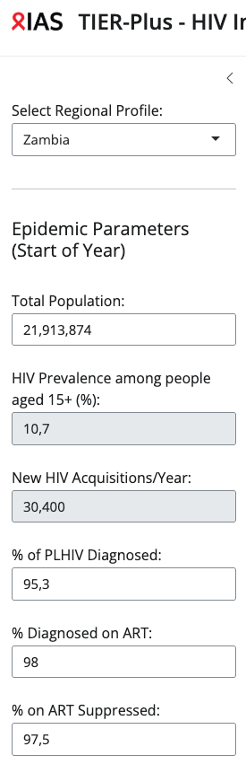
What goes in (inputs 1)
Select the country
Confirm (or edit) epidemic parameters (greyed out cannot be modified)

Slide 6
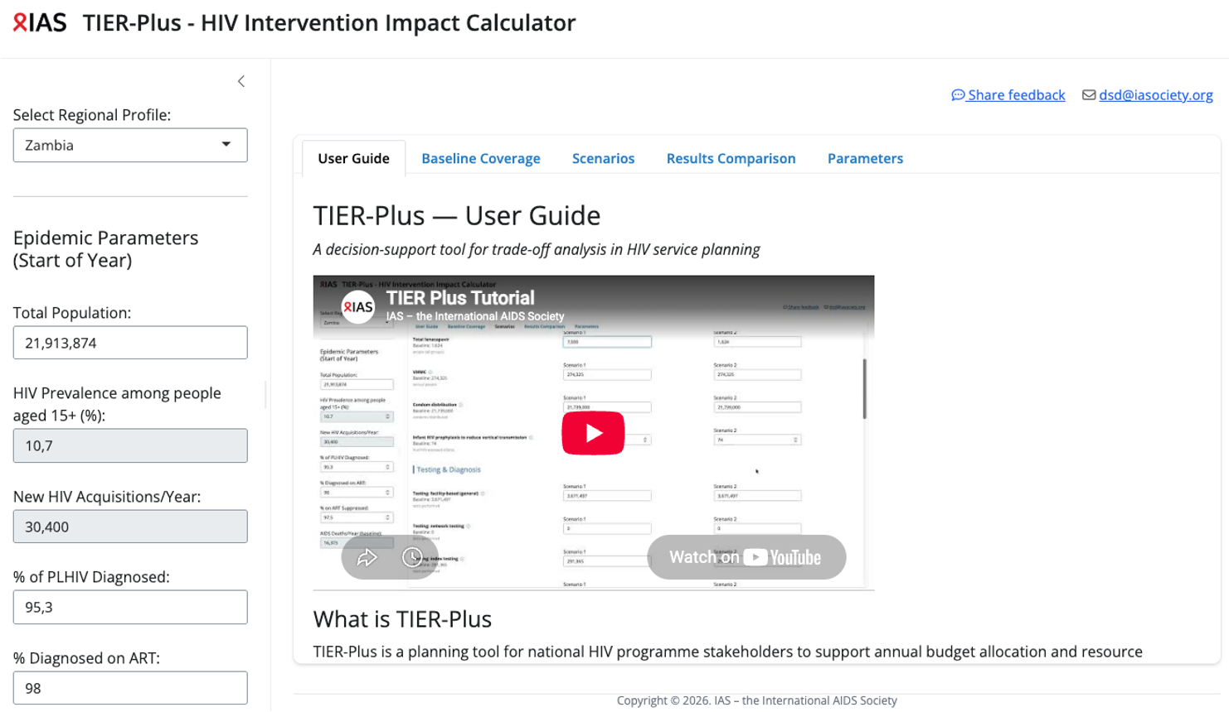

Slide 7
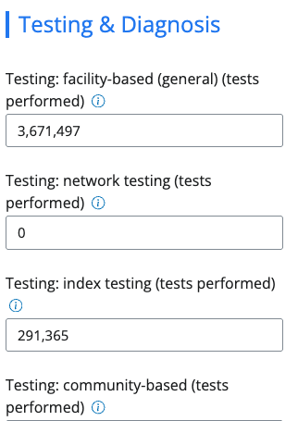
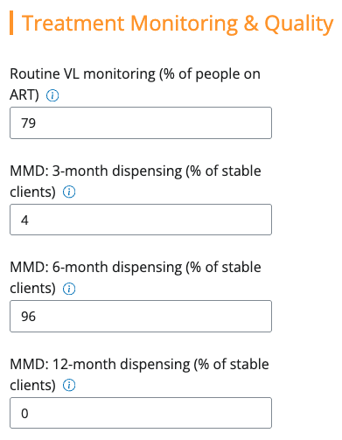
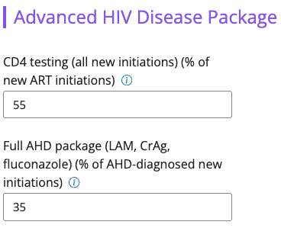
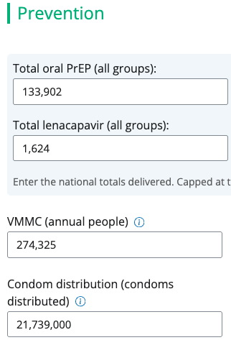
What goes in (inputs 2)
c. Baseline interventions (coverage)
For prevention
For testing and diagnosis
For treatment monitoring and quality
For retention and adherence support
For advanced HIV disease
Important note!
Default data is provided → Users can customize if better national data are available.

Slide 8
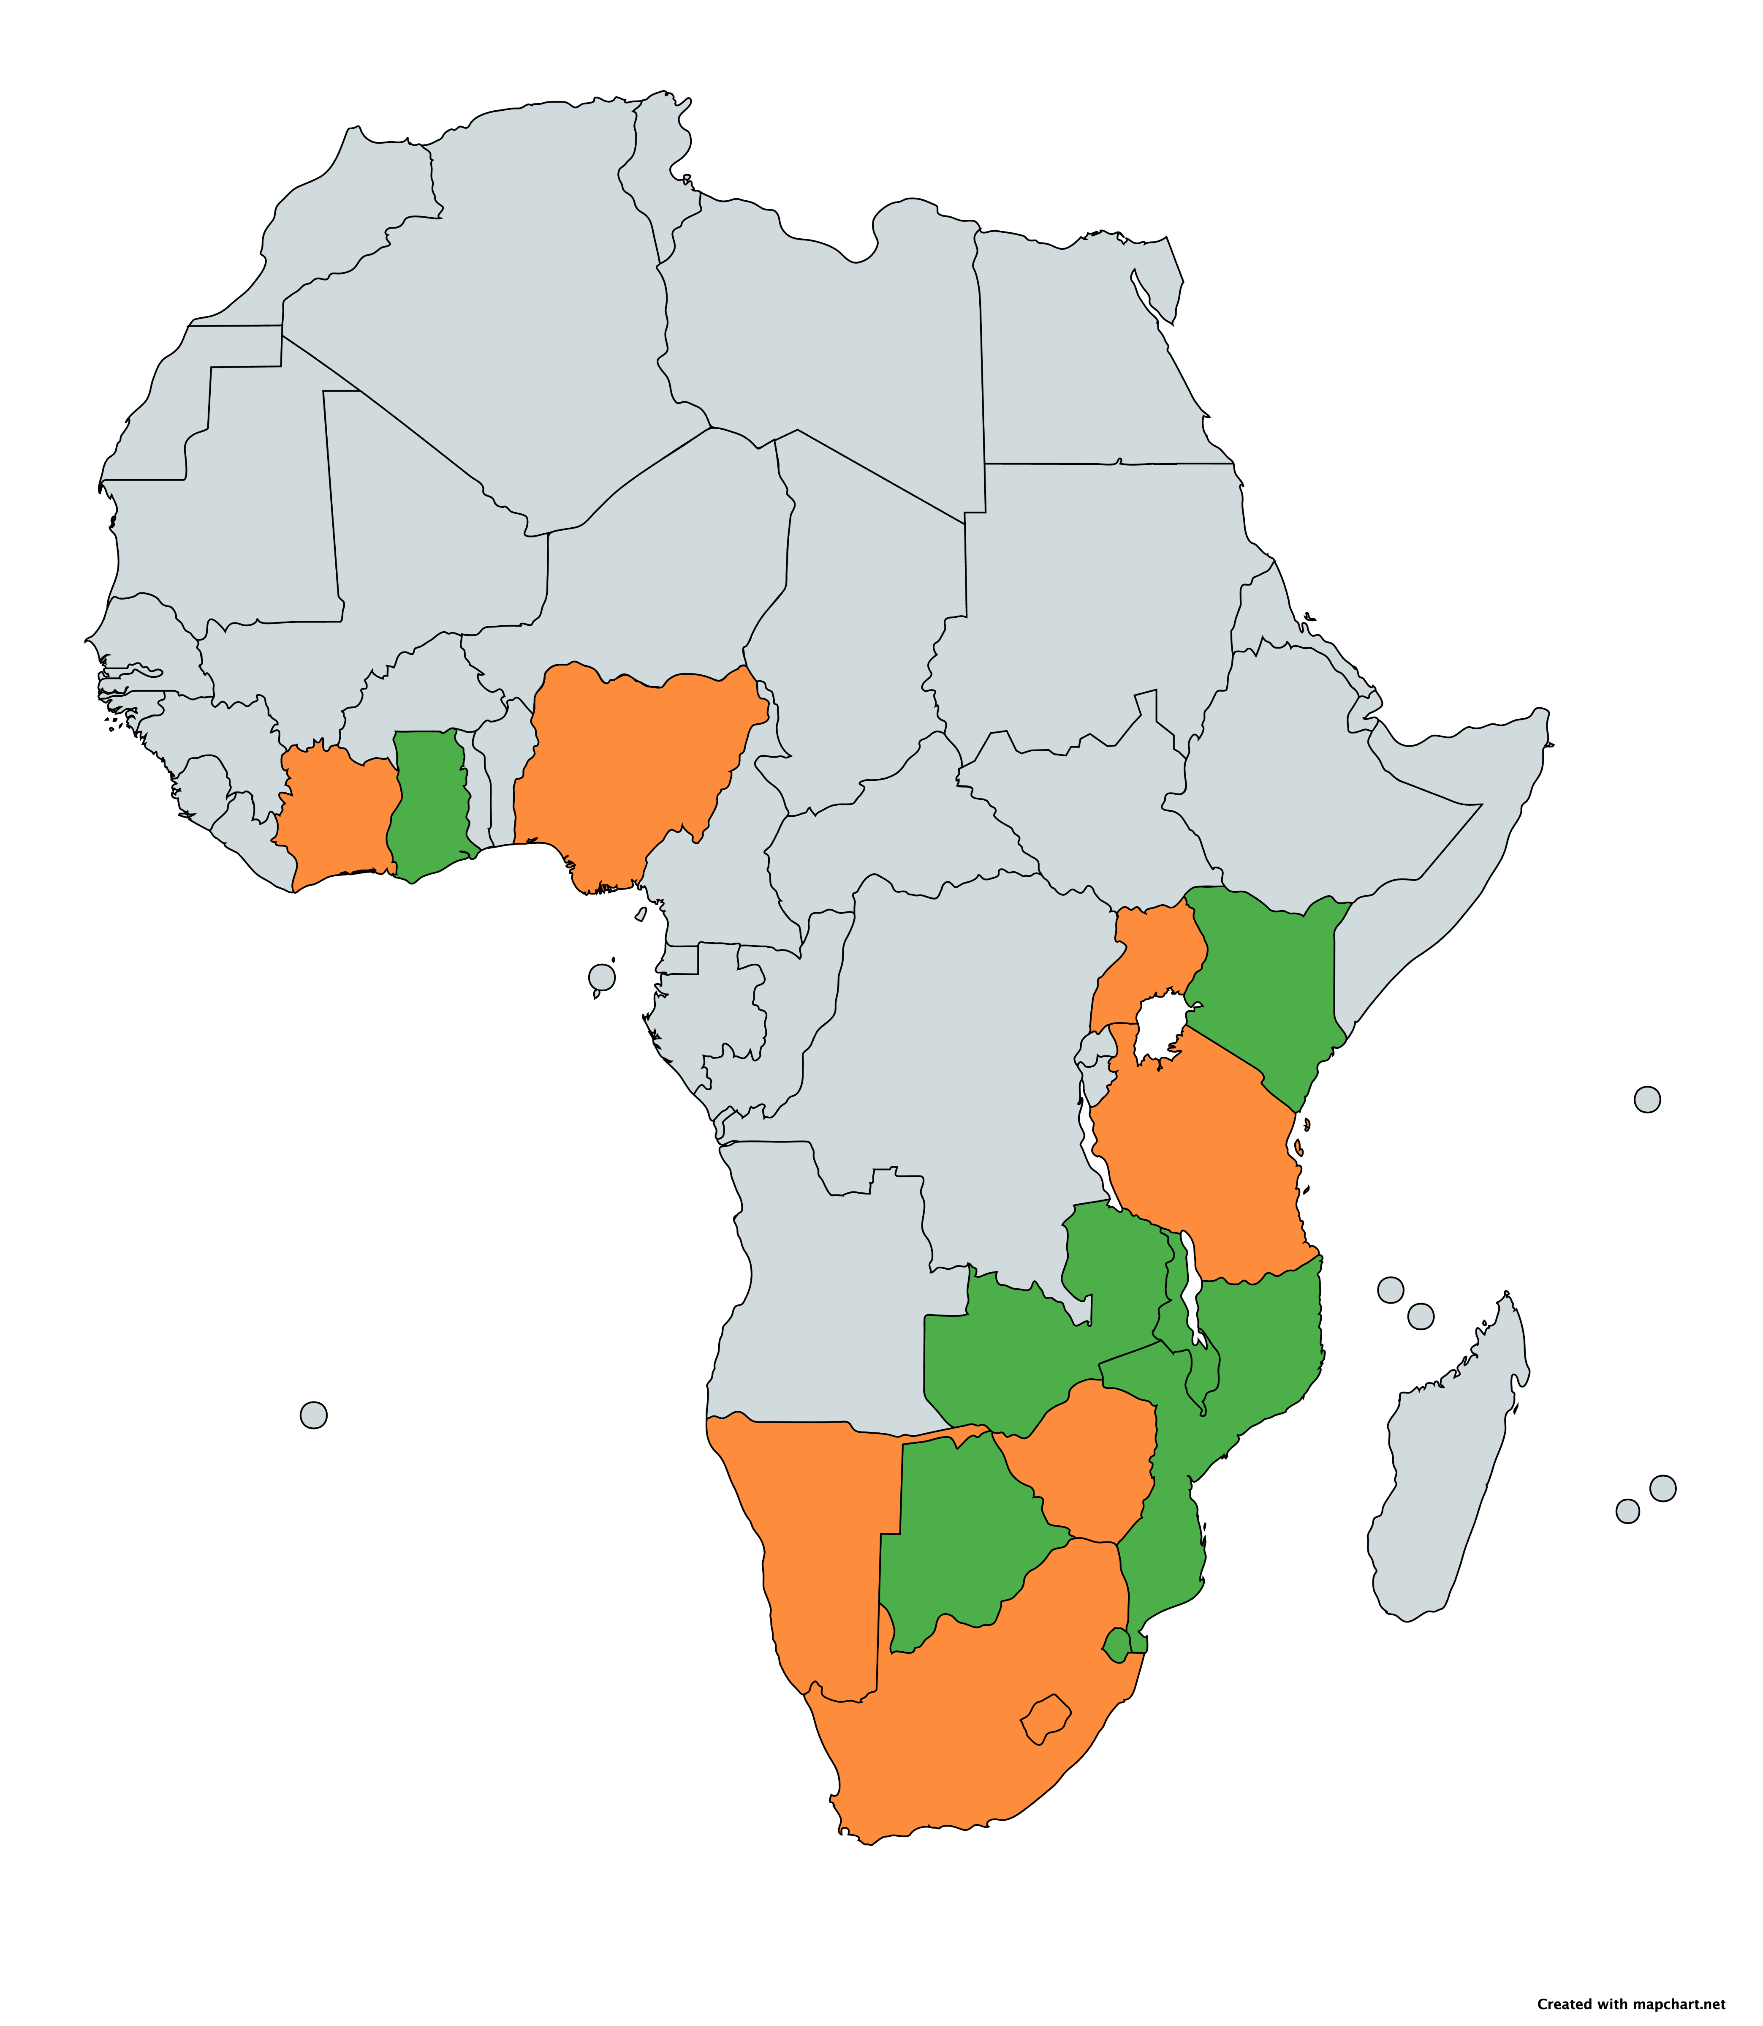
Countries represented in TIER-Plus
Uganda
Baseline data values reviewed and updated by in-country teams
Baseline data values from publicly available resources and literature
Côte d’Ivoire
Ghana
Nigeria
Kenya
Tanzania
Malawi
Zambia
Namibia
Mozambique
Zimbabwe
South Africa
Eswatini
Lesotho

Slide 9
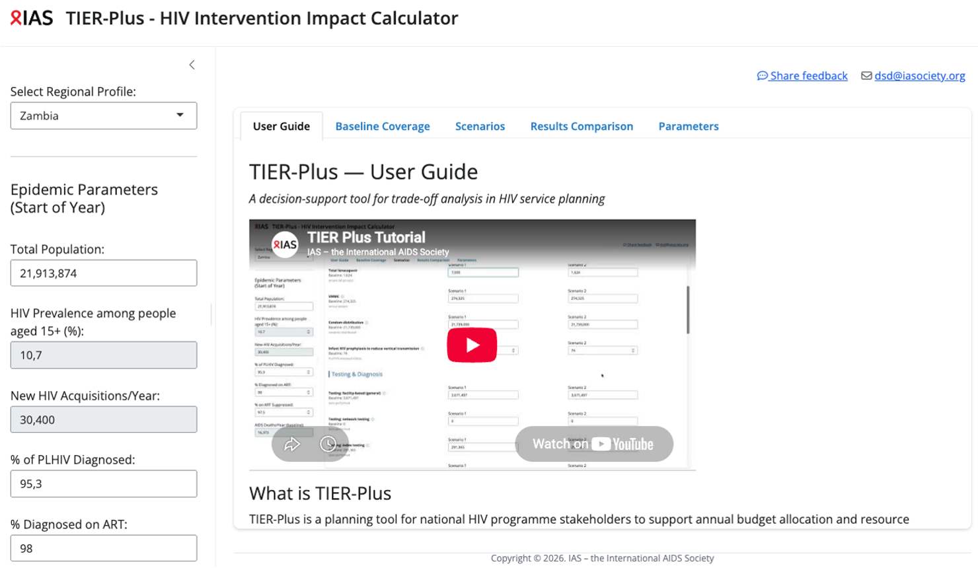

Slide 10

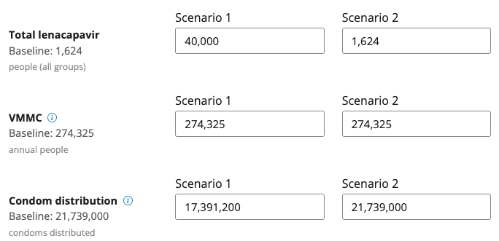
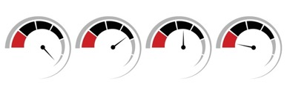
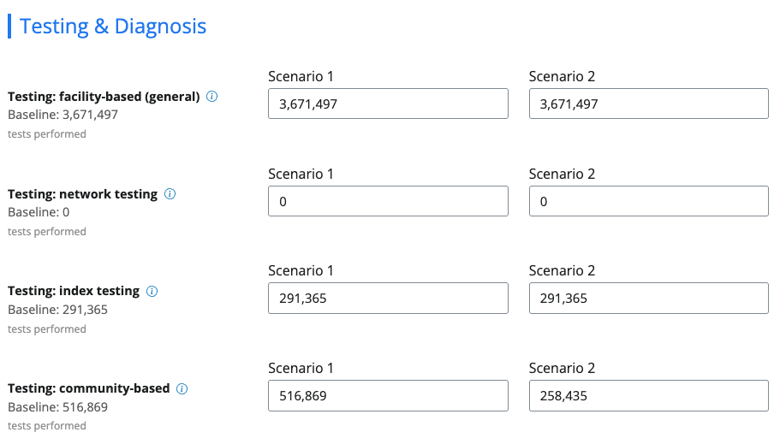
Then it’s time to play –
or build scenarios
For example:
Scenario 1: Reducing condoms while increasing lenacapavir
Scenario 2: halve community testing
Adapt the coverage of different interventions (populate different scenarios for comparison)
Add more interventions, and/or take some away
With this information, more and less of different interventions, TIER-Plus can then compare the impact on costs and outcomes

Slide 12
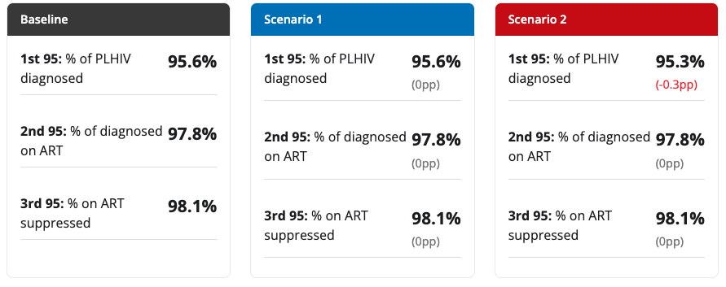
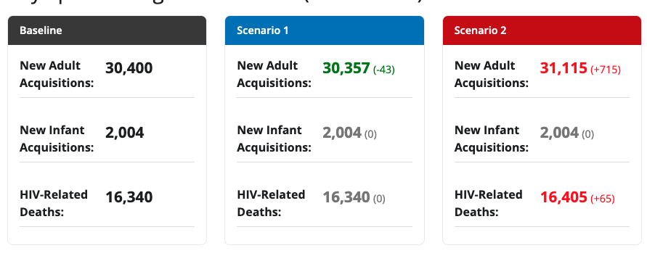
What TIER-Plus produces (outputs) 1/3
→ Two scenarios compared to the baseline
1-year outputs
a. Progress towards 95-95-95s
b. Key epidemiological outcomes

Slide 13
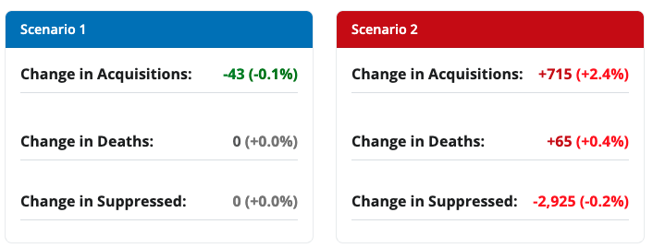
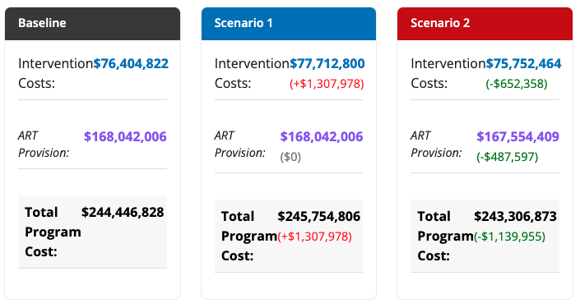
What TIER-Plus produces (outputs) 2/3
c. Health outcomes (relative to baseline)
d. Cost analysis

Slide 14
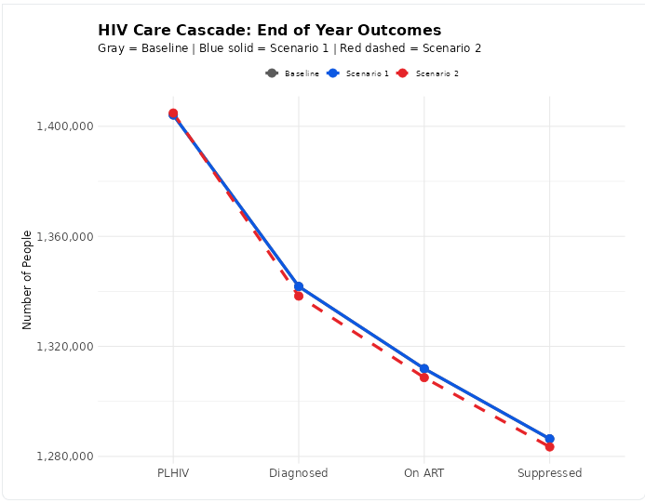
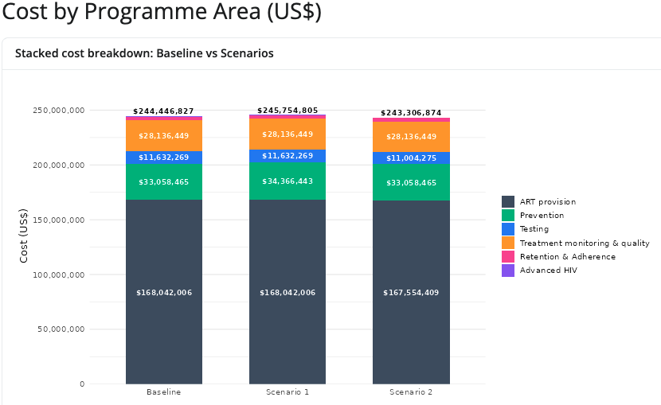
What TIER-Plus produces (outputs) 3/3
e. Impact on HIV care cascade
f. Cost breakdown

Slide 15
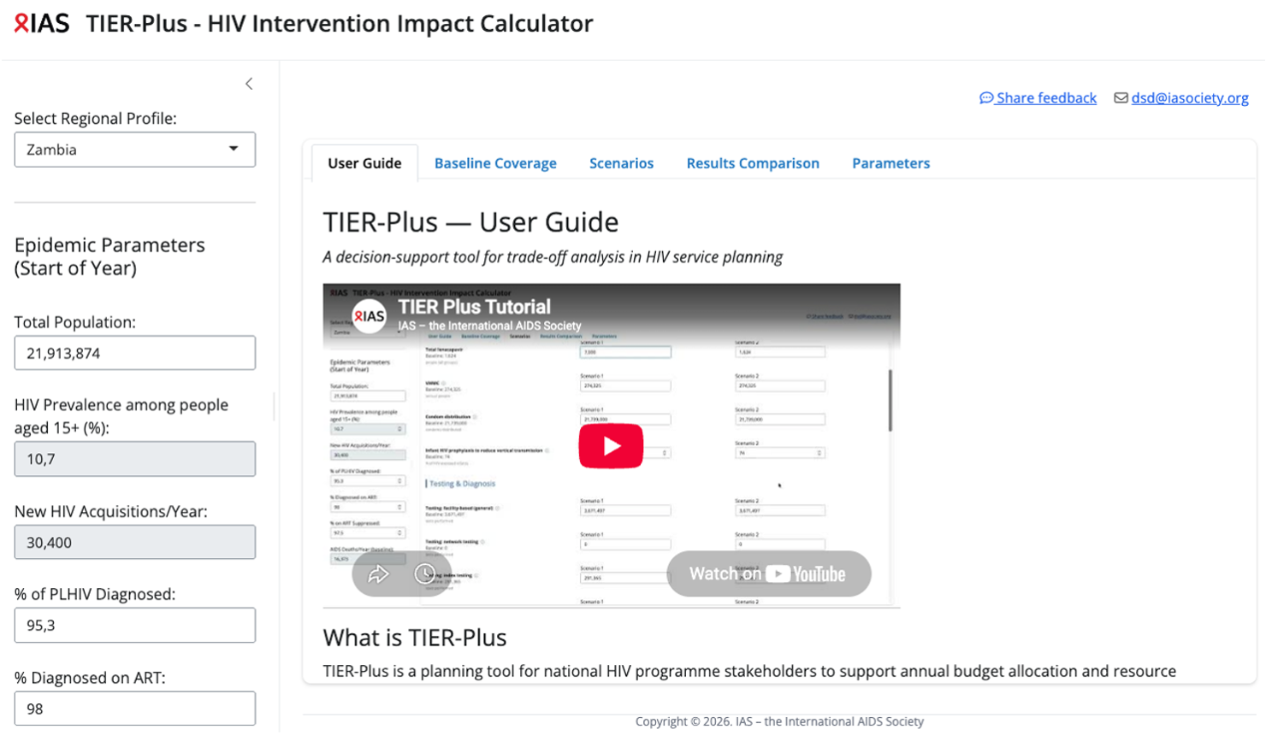

Slide 16
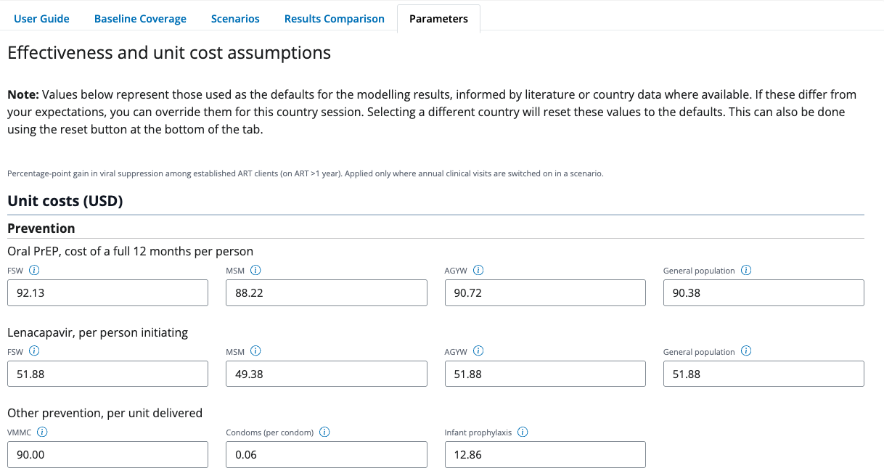
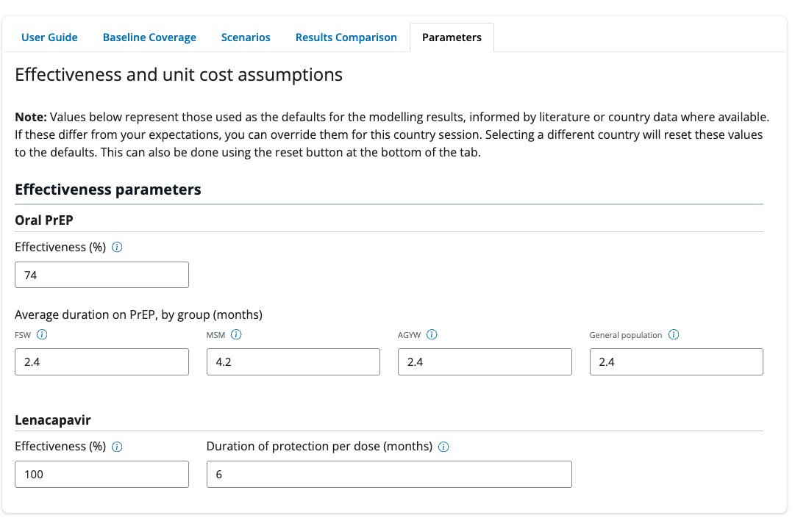
What if you want to adjust the assumptions?

Slide 17
What TIER-Plus can and cannot do
✅ What TIER-Plus can do
❌ What TIER-Plus cannot do
✅ Support decision making conversations at a national level
✅ Look at the impact across the cascade of multiple interventions
✅ Give an understanding of relative impact of different interventions on both outcomes and cost
❌ Provide exact cost estimates for budgeting
❌ Give long-term estimates on epidemic impact
❌ Replace intervention-specific planning (use DMPPT, PrEP-it, etc.)
❌ INTEGRATION

Slide 18
TIER-Plus pilot, launch and feedback collection (so far)
Initial pilot
Tier Updates
Launch AIDS 2026
Tier Updates
Pilot phase with team members from Zambia, Malawi & Mozambique
Feedback: survey responses
Update several elements of TIER-Plus based on pilot feedback (not all)
TIER-Plus launched at AIDS 2026.
Symposium and several workshops to collect further feedback from new and prior users
Where we are now

Slide 19
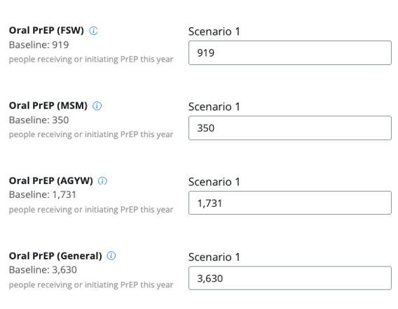
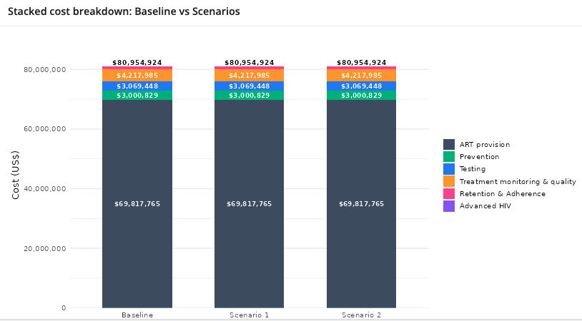
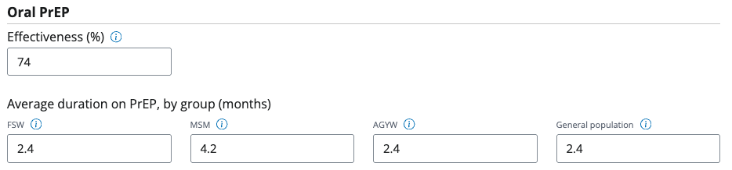
The piloting phase
The piloting phase had resulted in several meaningful changes before the AIDS 2026 launch:
✔️ PrEP targeting by sub-population
✔️ Inclusion of 6-monthly clinical visits vs 12- monthly clinical visits
✔️Output including cost breakdown by category of costs
✔️ Users able to update cost and effectiveness parameters

Slide 20
Feedback from pilot phase and AIDS sessions generated many other suggestions/additions
Feedback/ Potential next steps
Adding additional countries
PrEP targeting to pregnant and breastfeeding women
Include a third scenario option
Greater capabilities to upload and share setting between sessions and team members
Expanded documentation on assumptions and sources of data – particularly for cost and effectiveness parameters
Expanded list of community interventions and impact
Additional cost breakdown by type – HR, commodities, demand creation
Subnational models
Including adoption of new technologies and policies e.g frequency of routine viral loads
Projections to 3-years

Slide 21
TIER-Plus is a living tool
We need and want your feedback to make TIER-plus as useful as possible!
What else would you like to see?
Please explore and provide feedback!

Slide 22
Thank you

